Slide 1
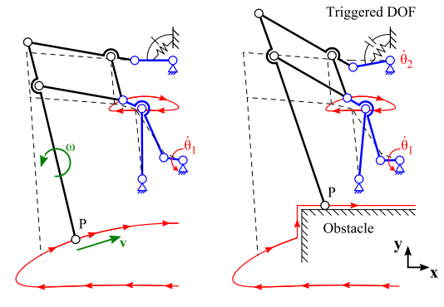
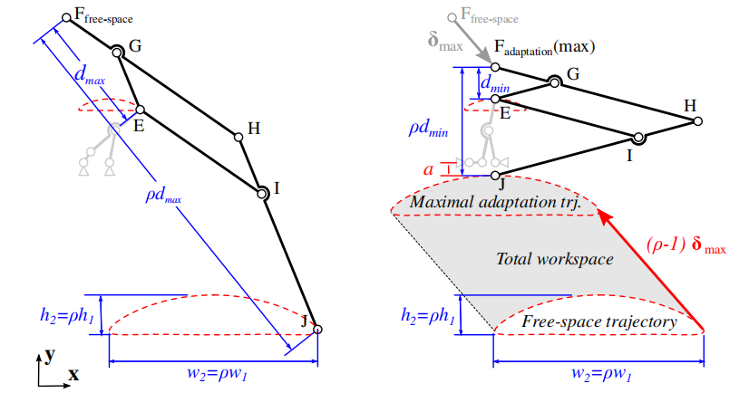
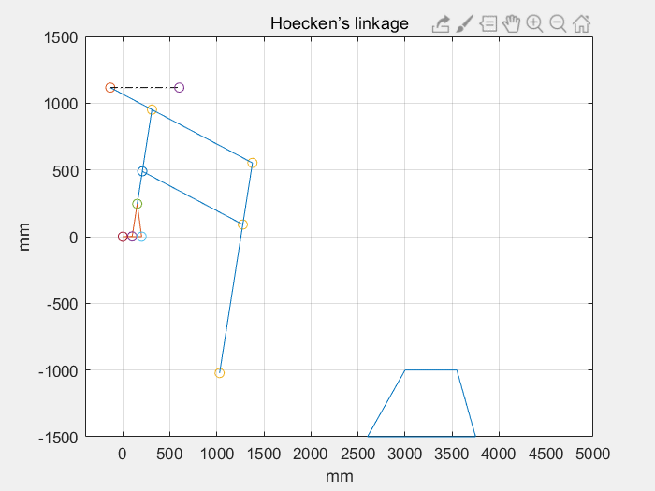
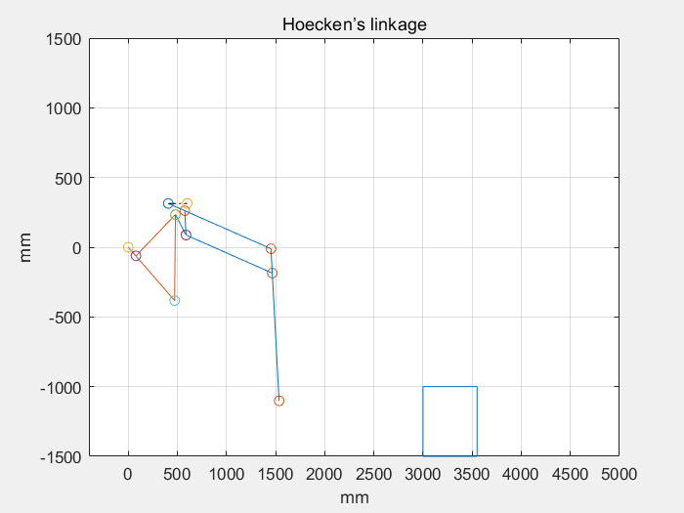
Project Experience
  Adaptive Leg Structure (MITACS)
Analysis of connecting rod structure
Analysis of connecting rod structure
Optimization
Simulation
Simulation
Notes:
突出交叉目标，以及如何落实交叉举措

Slide 2
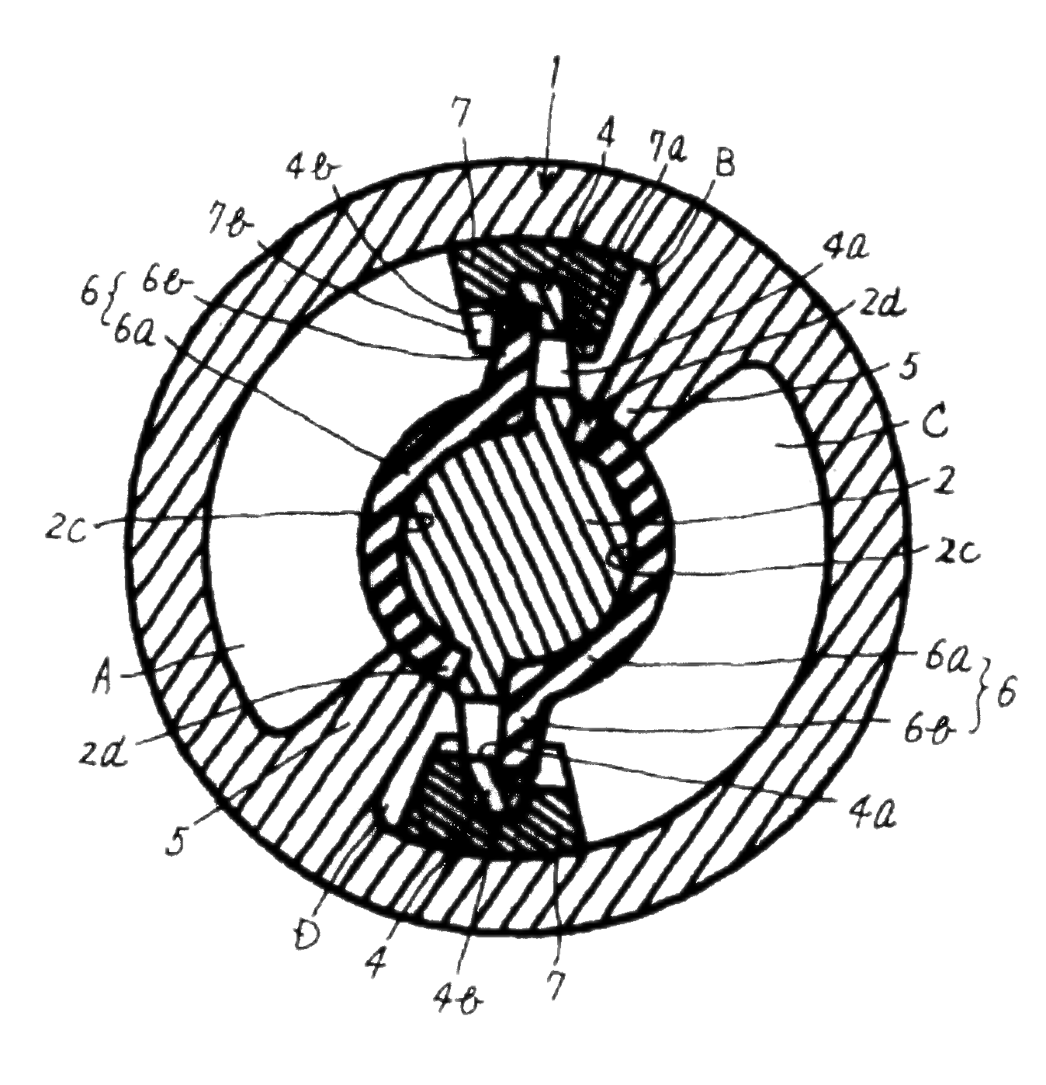
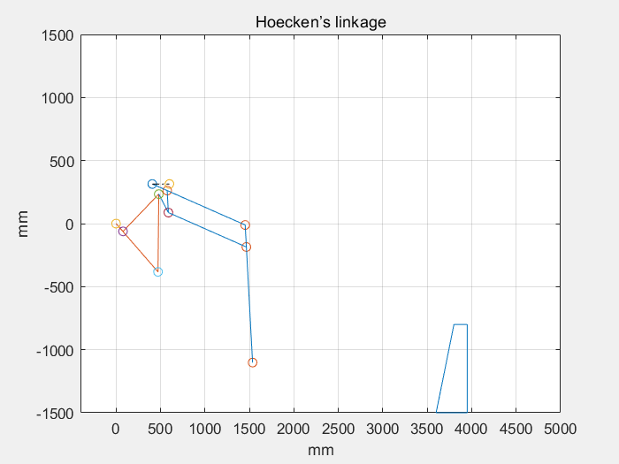
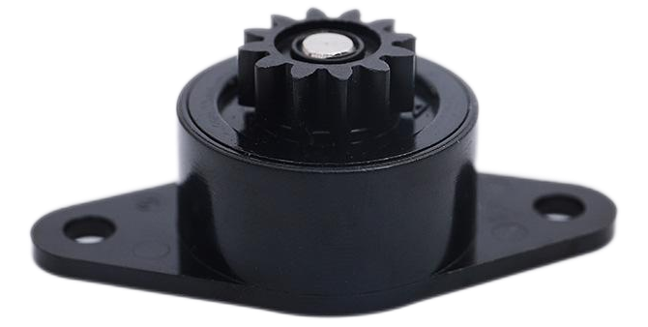
Project Experience
  Adaptive Leg Structure (MITACS)
Installation of damper
Simulation without damping device
Simulation with damping device
Notes:
突出交叉目标，以及如何落实交叉举措

Slide 3
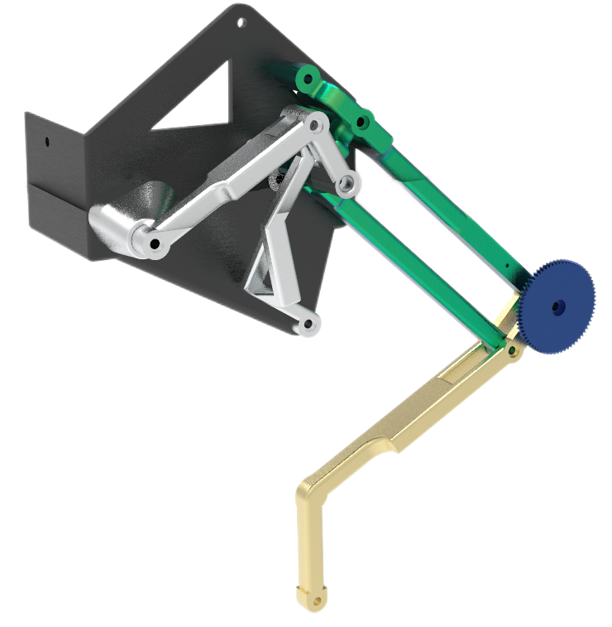
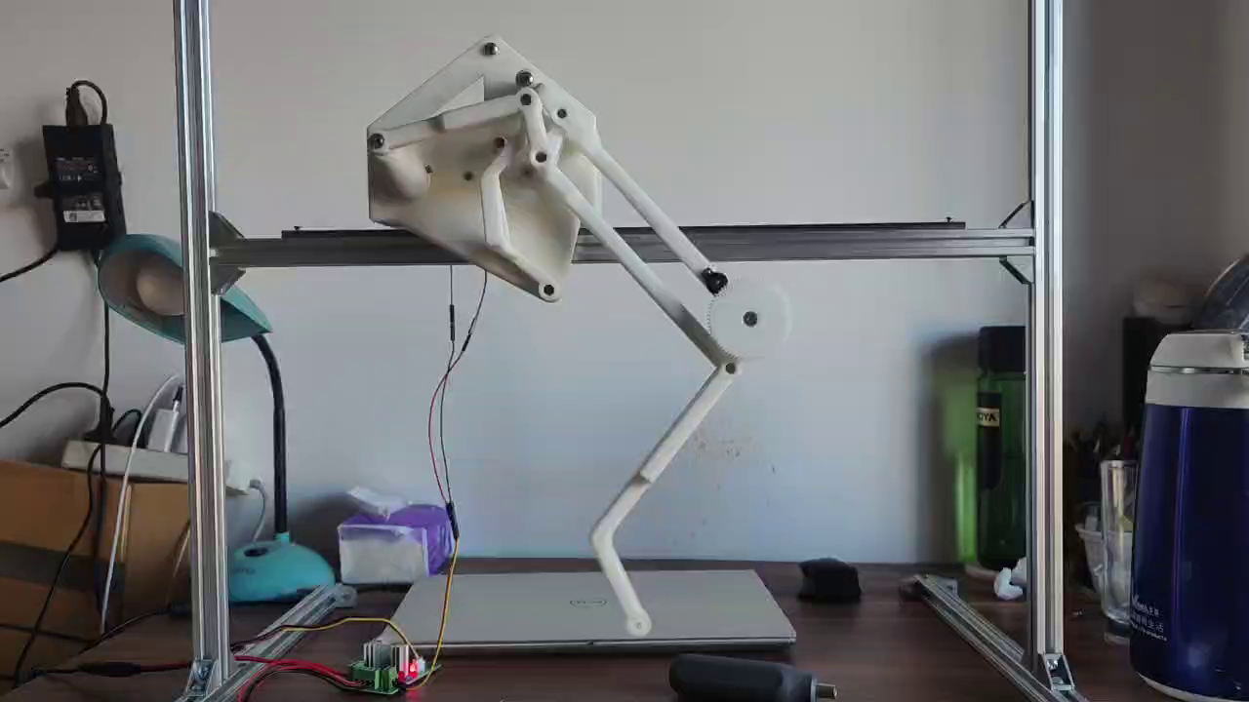
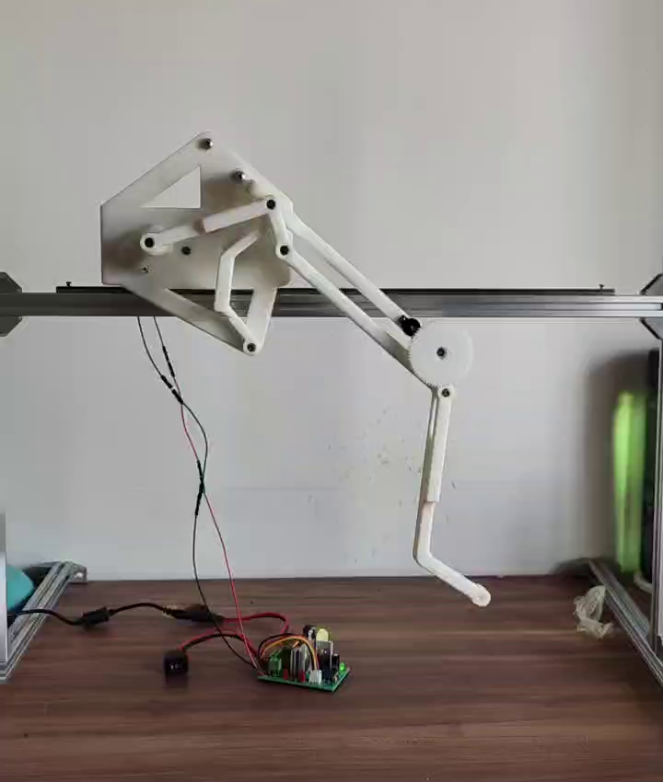
Project Experience
  Adaptive Leg Structure (MITACS)
Assembly schematic
Regular gait running experiment
Adaptive obstacle avoidance experiment
Notes:
突出交叉目标，以及如何落实交叉举措

